Slide 1
Virtual Assistant
Submitted in the partial fulfillment for the award of the degree of
BACHELOR OF ENGINEERING
IN
Artificial Intelligence and Machine Learning
Submitted by:
Naman Chib
Arshiya Sarmai
Anmol Chopra
Under the Supervision of:
Prof. Mohammad Nadeem Uddin
Department of AIT-CSE
DISCOVER . LEARN . EMPOWER
1

Slide 2
Outline
Introduction to Project
Problem Formulation
Objectives of the work
Methodology used
Results and Outputs
Conclusion
Future Scope
References
2

Slide 3

Introduction
Virtual Assistants are software programs that help you ease your day to day tasks, such as making to-do lists, setting alarms, book movie and show tickets, setting reminders, open any site on the browser, play music and providing weather reports and real time information such as news, location etc.
It enables users to speak natural language voice commands in
order to operate.
It could be useful for getting a more convenient life
and it will be helpful for the people who have
disabilities for manual operations.

Slide 4

Introduction
The mass adoption of artificial intelligence in every industry and in user’s everyday lives is fueling the shift towards these type of software and in the coming times it would become a day-to-day life assistant for managing work for almost everyone.

Slide 5
Introduction
Voice searches have dominated over text search in the recent times.
The analysts are already predicting that 50% of searches will be via voice by 2022.
Virtual assistants are turning out to be smarter than ever. Allow your intelligent assistant to make
1. Email work for you
2. Pick out important information
3. Automate processes and deliver personalized responses.

Slide 6

Problem Formulation
Virtual assistants can tremendously save your time.
We spend hours in online research and then making the report in our terms of understanding. Virtual assistant can do that for you. Provide a topic for research and continue with your tasks while virtual assistant does the research.
The project draws its inspiration from Virtual assistants like Cortana for Windows and Siri for iOS.
6

Slide 7

Problem Formulation
One of the main advantages of voice searches is their rapidity. In fact, voice is reputed to be four times faster than a written search. In this respect, the ability of personal assistants to accurately recognize spoken words is a pre-requisite for them to be adopted by consumers.

Slide 8

Objectives
Main objective of building personal voice assistant software is using semantic data sources available on the web, user generated content and providing knowledge from knowledge databases.
It can be proved very useful for the people
who cannot perform typing and are unable
to do some operations manually. So, it will
allow them to use their natural language to
perform various functions.
8

Slide 9
Methodology used
In this project, detailed study of voice to text conversion will be done.
We must install python 3 and on that we will be implementing different libraries like numpy, Json , Tkinter, speech recognition,OpenCV and pyaudio. Various parameters will be identified to evaluate the proposed system.
The prospect of the program can be more applications or products developed using the voice control, and it could in some sense change the working forms that is totally different from the traditional form. As people can easily operate and have a lot of fun from it, it owns an enlightened prospect as SIRI succeed in attracting people in the market.

Slide 10
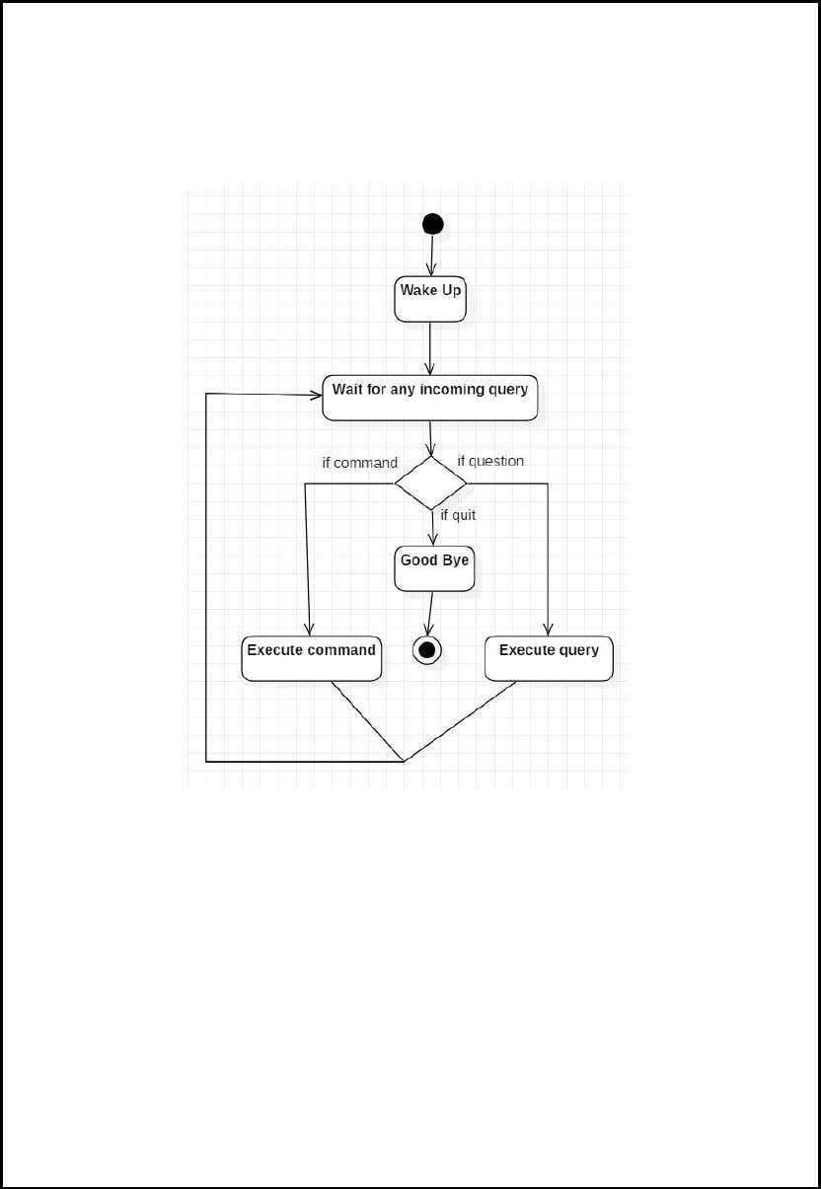
Methodology used
Comparison of new implemented approach with existing approaches will be done.

Slide 11
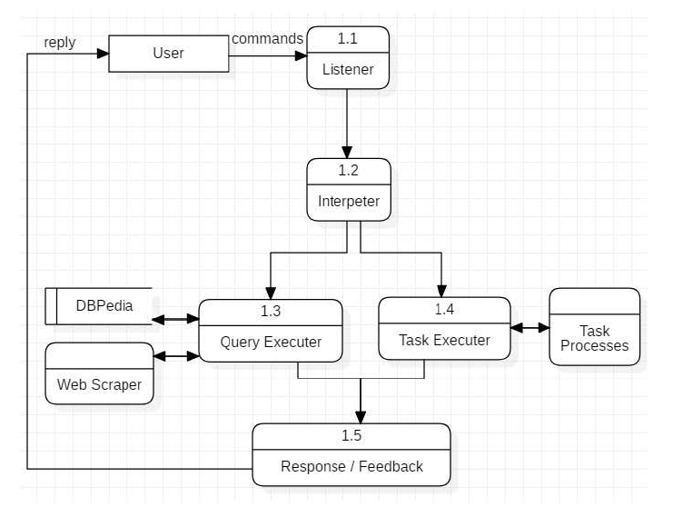

Slide 12
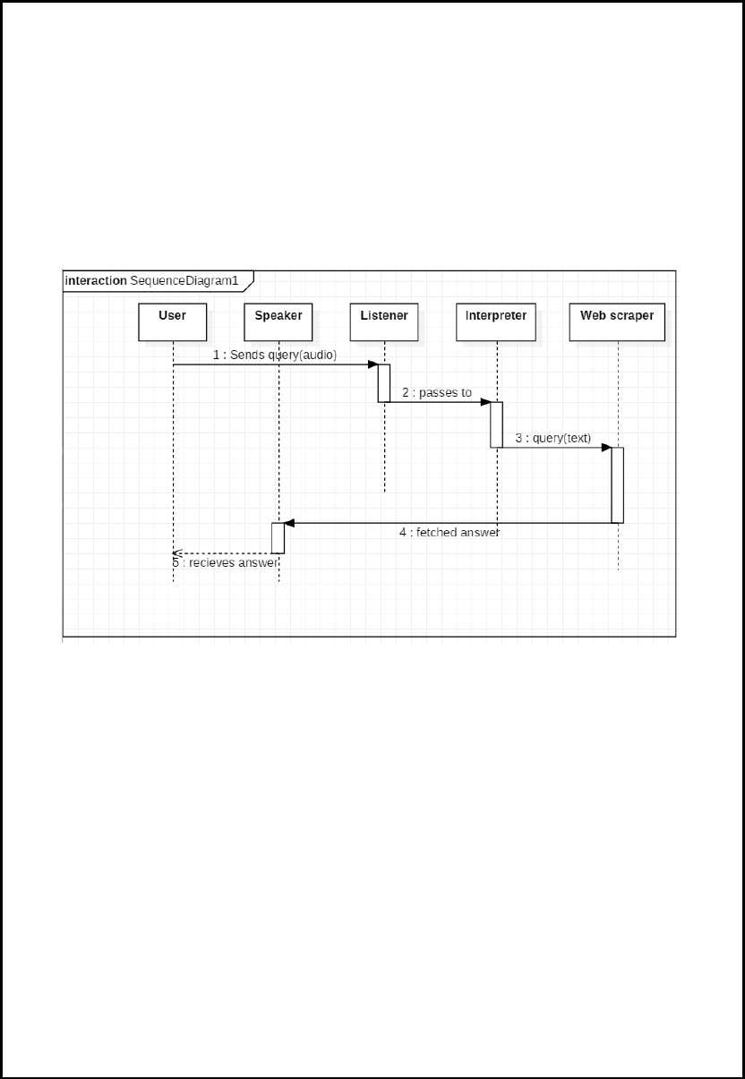

Slide 13
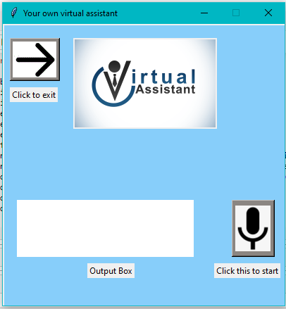
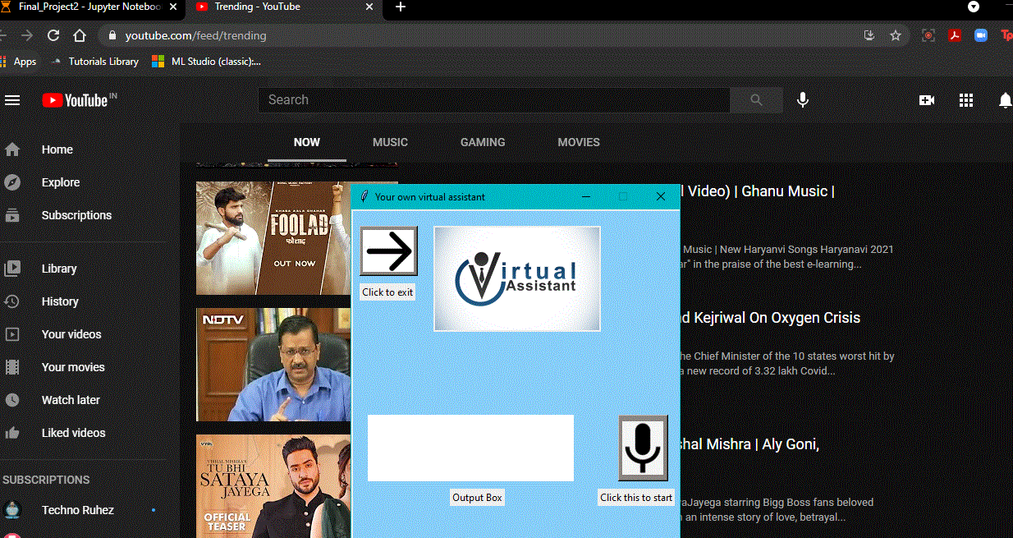
Results and Outputs
13

Slide 14
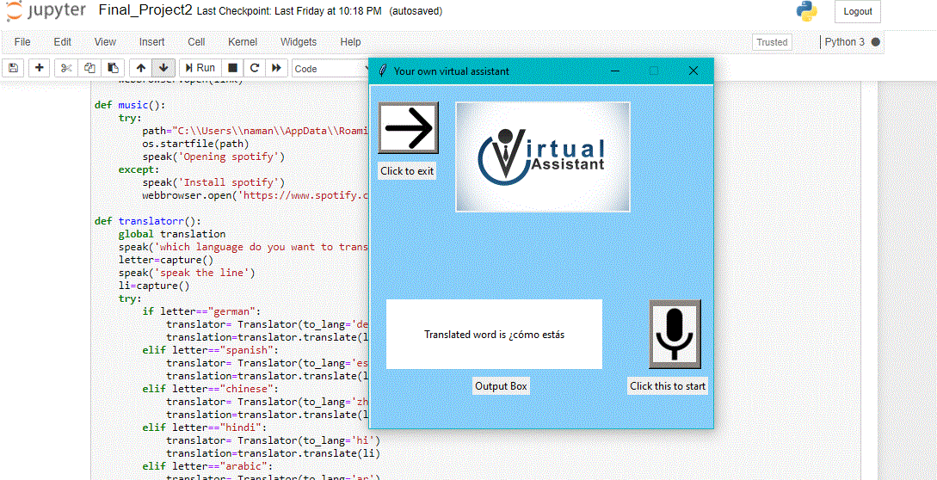

Slide 15
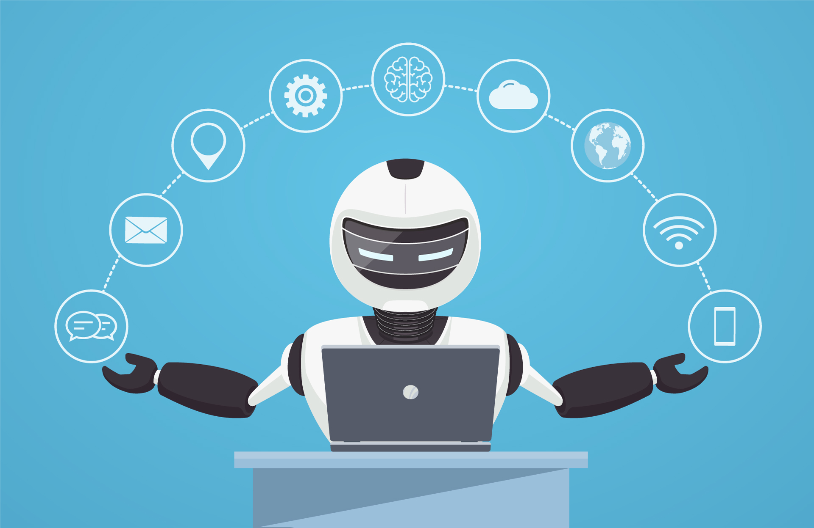
Conclusion
Through this voice assistant, we have automated various services using voice command.
This engages the ability to communicate socially through natural language processing, holding and analyzing data within the context of the user.
Virtual assistants are already emerging in the workplace as taskmasters, completing repetitive tasks and freeing up time for workers to focus on more complex tasks.
15

Slide 16

Future Scope
As machine learning progresses, we may see virtual assistants become smarter and begin to learn and predict customer needs.
The number of IoT devices such as smart thermostats and speakers are giving voice assistants more utility in a connected user’s life.
We can assume that virtual assistants are here to stay and could be embedded in all aspects of our lives in the future, including our work lives.

Slide 17
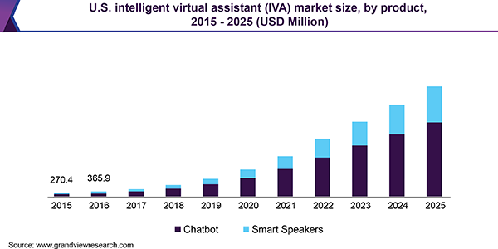

Slide 18
References
[1] http://en.wikipedia.org/wiki/Siri_(software)
[2] http://en.wikipedia.org/wiki/Smartphone
[3] http://yudian.voicecloud.cn/
[4] http://en.wikipedia.org/wiki/Extreme_programming
[5] http://en.wikipedia.org/wiki/Cloud_computing
[6] http://en.wikipedia.org/wiki/Extreme_programming
[7] http://www.mysql.com/why-mysql/
[9] http://www.windowsazure.com/en-us/home/features/sql-azure/

